Slide 1
Data Governance And Security
Submitted in the partial fulfillment for the award of the degree of
BACHELOR OF ENGINEERING
IN
BIG DATA AND ANALYTICS
Submitted by:
20BCS3908 Kanwar Arinjai Singh 20BCS3873 Abhinav Sharma 20BCS3945 Anupam Kumar
Under the Supervision of:
Navjeet Kaur (E16069)
Department of AIT-CSE
DISCOVER . LEARN . EMPOWER

Slide 2
Outline
Introduction to Project
Problem Formulation
Objectives of the work
Methodology used
Results and Outputs
Conclusion
Future Scope
References

Slide 3
Introduction to Project
Data governance and security are essential components of any organization's strategy to protect sensitive information, maintain regulatory compliance, and ensure data is used effectively to drive decision-making and innovation.
The Data Governance and Security Project is a comprehensive initiative aimed at establishing and enhancing the policies, processes, and technologies necessary to manage data effectively and protect it from unauthorized access, breaches, and other threats.

Slide 4
Problem Formulation
Inadequate data security measures and controls expose the organization to the risk of data breaches, unauthorized access, and cyber threats. Data breaches, reputational damage, financial losses, and potential legal consequences.
Data inconsistencies, inaccuracies, and lack of data validation processes compromise the reliability and trustworthiness of data assets.
The problems outlined above collectively contribute to a high level of risk and inefficiency in the organization's data management practices. These issues not only pose a threat to data security but also hinder the organization's ability to leverage data as a strategic asset. Addressing these problems through the Data Governance and Security Project is essential to mitigate risks, enhance data integrity, maintain compliance, and empower the organization to make informed decisions based on reliable data

Slide 5
Objectives of the work
Data Integrity: Ensure the accuracy, consistency, and reliability of data throughout its lifecycle. This involves preventing data corruption, errors, and unauthorized modifications.
Data Privacy: Protect sensitive and personally identifiable information (PII) from unauthorized access, disclosure, or misuse, in compliance with data protection laws and regulations.
Data Security: Safeguard data from external threats (e.g., hackers, cyberattacks) and internal risks (e.g., employee negligence) by implementing robust security measures, such as encryption, access controls, and intrusion detection systems.
Data Quality: Maintain high-quality data by defining standards, establishing data quality controls, and implementing data cleansing processes to remove duplicates, inconsistencies, and inaccuracies.
Data Governance Framework: Establish a comprehensive data governance framework that outlines roles, responsibilities, processes, and policies for effective data management.

Slide 6
Methodology used
Data Quality:
Focuses on maintaining and improving the accuracy, consistency, and reliability of data.
Involves data profiling, cleansing, validation, and monitoring to ensure data quality.
Enhances trust in data, leading to better decision-making and operational efficiency.
Data Stewardship:
Assigns responsibility for specific data domains or sets to data stewards.
Data stewards oversee data assets, enforce data governance policies, and resolve data-related issues.
Ensures accountability and ownership of data within the organization.
Data Protection and Compliance:
Addresses data security and privacy concerns to protect sensitive and confidential data.
Ensures compliance with regulatory requirements (e.g., GDPR, HIPAA) and industry standards.
Implements access controls, encryption, and auditing to safeguard data.
Data Management:
Involves the holistic management of data throughout its lifecycle.
Encompasses data cataloging, metadata management, data lineage, and data integration.
Optimizes data storage, retrieval, and archival processes for efficiency and effectiveness.

Slide 7
Planning
Assessment: Evaluate current data practices and security gaps.
Requirements: Define needed data governance, security measures, and compliance.
Framework Design: Develop comprehensive policies, data classification, and access controls.
Technology Integration: Implement security tools, encryption, and monitoring systems.
Training: Educate employees on data handling, security protocols, and compliance.
Testing: Thoroughly test access controls, encryption, and monitoring mechanisms.
Rollout: Deploy the framework, train staff, and promote security awareness.
Monitoring: Continuously monitor data, assess security, and address emerging threats.
Documentation: Document policies, procedures, and implemented measures.
Continuous Improvement: Regularly update and refine the framework based on insights and feedback.

Slide 8
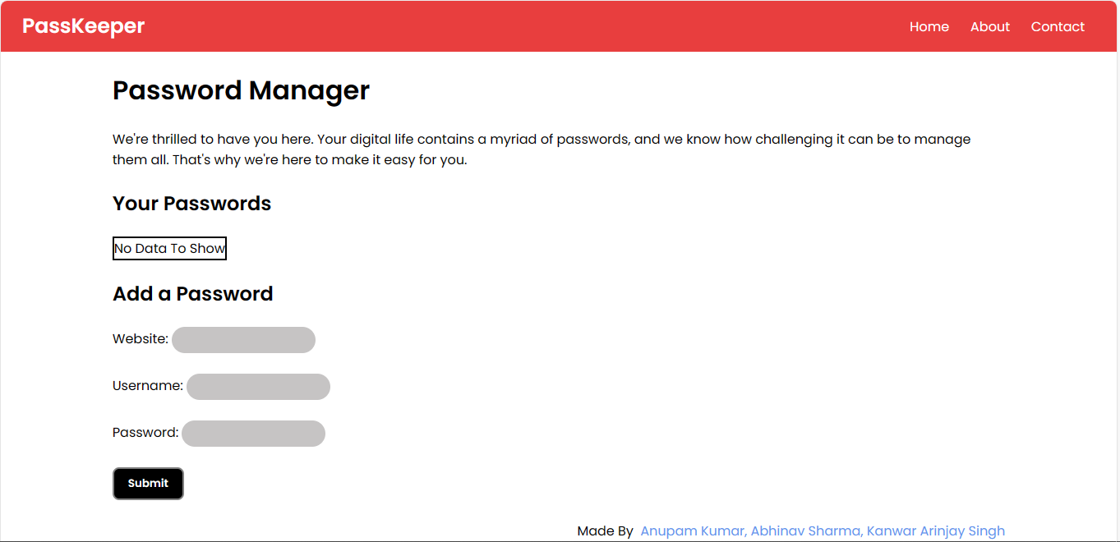
Preliminary Design

Slide 9
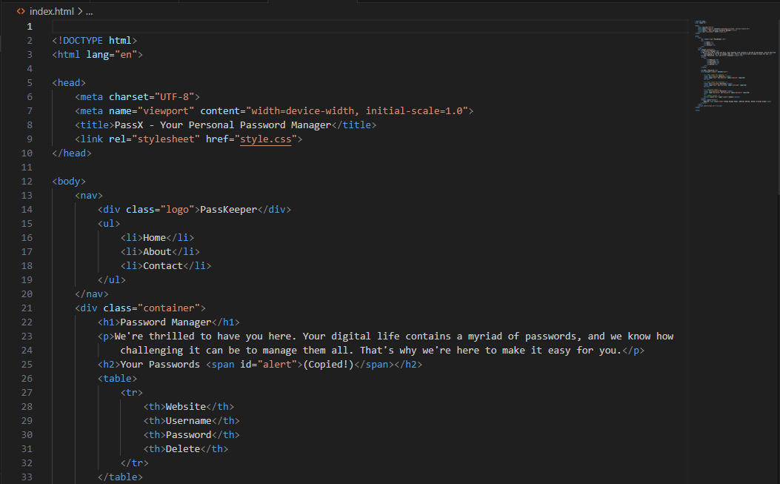
Results and Outputs- CODE

Slide 10
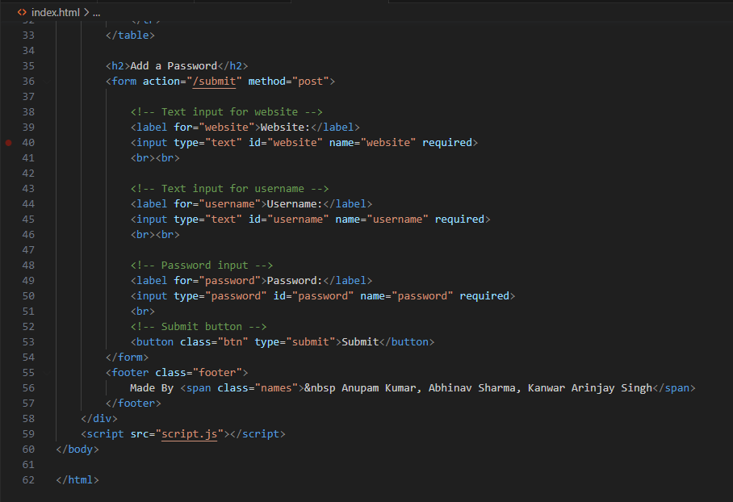
Results and Outputs- CODE

Slide 11
Results and Outputs- OUTPUT

Slide 12
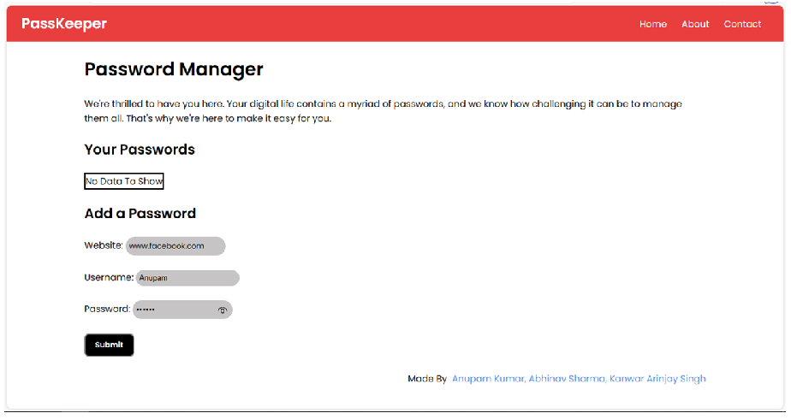
Results and Outputs- OUTPUT

Slide 13
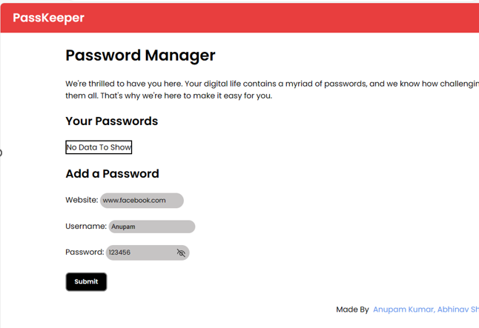
Results and Outputs- OUTPUT

Slide 14
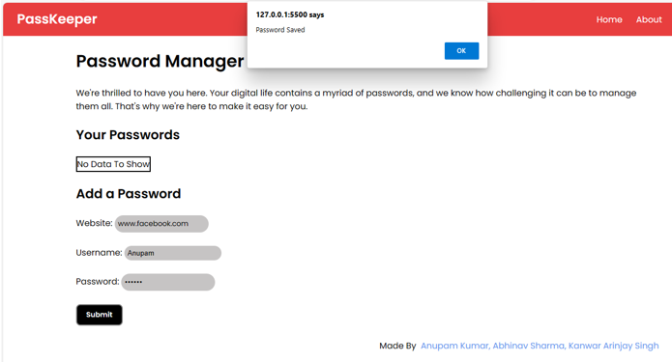
Results and Outputs- OUTPUT

Slide 15
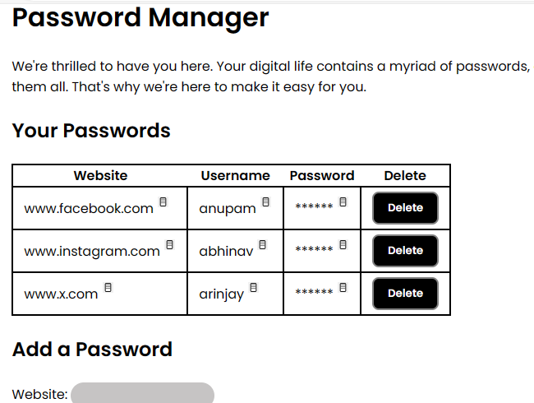
Results and Outputs- OUTPUT

Slide 16
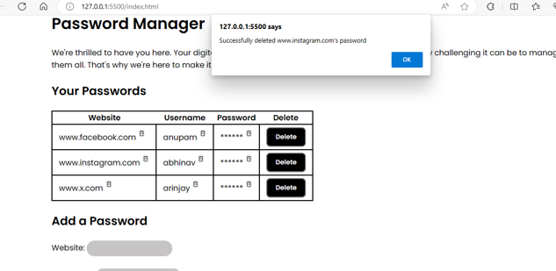
Results and Outputs- OUTPUT

Slide 17
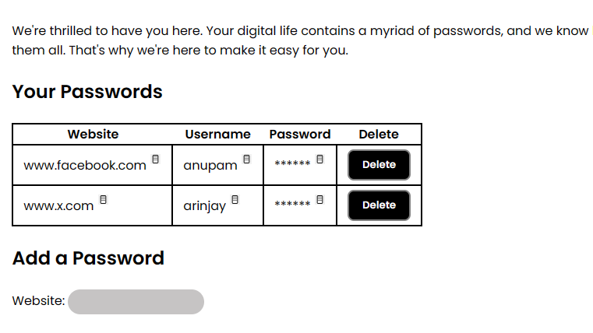
Results and Outputs- OUTPUT

Slide 18
Conclusion
Current datasets are missing considerable amounts of vital feature data for a variety of countries, making population and migration forecasting considerably more difficult to learn by machine.
This network could take in a feature matrix for each of the different countries for a single year and utilize a combination of attention-based architectures and fully-connected layers to predict migration.

Slide 19
Future Scope
Future work on this project should aim to repair the disconnect between successor state model and migration distribution model predictions. Additionally, successor state model architectures should be adjusted to better predict shifting concavities in the observed data.

Slide 20
References
Abraham, R., Schneider, J., & vom Brocke , J. (2019). Data governance: A conceptual framework, structured review, and research agenda. International Journal of Information Management, 49, 424-438.
Al-Badi, A., Tarhini, A., & Khan, A. I. (2018). Exploring big data governance frameworks. In Procedia Computer Science (Vol. 141, pp. 271–277). Elsevier B.V. https://doi.org/10.1016/j.procs.2018.10.181
Al-Ruithe, M., Benkhelifa, E., & Hameed, K. (2019). A systematic literature review of data governance and cloud data governance. Personal and Ubiquitous Computing, 23(5-6), 839-859.
Cheong, L. K., & Chang, V. (2007). The need for data governance: a case study. ACIS 2007 Proceedings, 100.
Cichy, C., &Rass, S. (2019). An overview of data quality frameworks. IEEE Access, 7, 24634-24648
Ballard, C., Compert, C., Jesionowski, T., Milman, I., Plants, B., Rosen, B., Smith, H.: Information Governance Principles and Practices for a Big Data Landscape. IBM (2014)

Slide 21
Batini, C., Scannapieco, M.: Data Quality: Concepts, Methodologies and Techniques. Springer, Heidelberg (2006).
D. Berdik, S. Otoum, N. Schmidt, D. Porter, and Y. Jararweh, ‘A survey on blockchain for information systems management and security’, Information Processing & Management, vol. 58, no. 1, p. 102397, 2021.
Bertot, J.C., Choi, H.: Big data and e-government: issues, policies, and recommendations. In: The Proceedings of the 14th Annual International Conference on Digital Government Research, pp. 1–10 (2013)
Cline, J.S.: The promise of data-driven care. N. C. Med. J. 75(3), 178–182 (2014).

